Slide 1
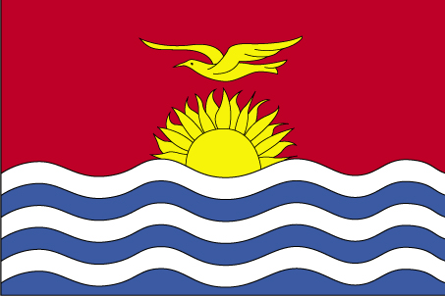
Manin ao aorakin taian aroka
Katauraoaki man mangan te Ununiki are e tabe ibukin totokoan maan ke aorakin taian aroka mai tinanikun Kiribati ao kateimatoan maeuraoin ke marurungin arokam

Slide 2
Kanoan te maroro
Oin tabera
Anga n totoko ao n tararua
Manin/aorakin aroka ake a tia n roko i Kiribati
Manin/aorakin aroka ake a tuai roko i Kiribati
Tuan uotakin aroka
Kauring

Slide 3
Oin tabera
Totokoan rokon manin ao aorakin taian aroka mai tinaniku ake a tuai roko i abara
Karaoakin te kakae iaon manin ao aorakin taian aroka ake a tia n roko i Kiribati
Kakaean anga ake a na kona n:
totokoa butinakon manin/aorakin taian aroka nakon taabo ake a tuai roko iai
Kauarerekean mwaitina
Kamaunanakoan matana

Slide 4
Aekakin te Tararua:
Tina riai n totokoi rokon manin ao aorakin aroka ake a tuai roko i abara
Katoto: maan ke aorakin aroka ake iai itinanikun Kiribati ao a tuai man kaoti I abara
Tina riai n tararuai ake a tia n roko i abara ao n totokoi bwa ana aki butinako nakon taabo ake a tuai roko iai.
Katoto: maan ke aoraki ake a tia n kaoti n tabeua abamwakoro ma a tuai roko iaon abamwakoro tabeua ke ea tia n kaoti n tabeua kawan te abamwakoro ma e tuai buta nakon kaawa ake tabeua.

Slide 5
Manin ke aorakin aroka aika a tia n roko I Kiribati ao ni kakoauaakaki bwa a rang n urubwai nakon taian aroka
Kimoan te kaibuke (Ship rat)
Te bekabeka (Mealy bug)
Te nango mainaina (Spiraling whitefly)
Bwabwai biitere (Taro beetle)
Ina iaon uanikai (Scale insect)
Nangon te uanikai (Fruitfly)
Bwata ni Mai (Breadfruit rot)

Slide 6
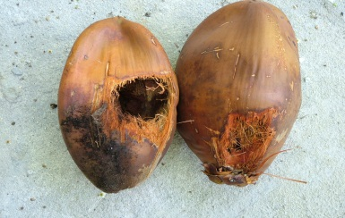
Kimoan te kaibuke (Ship rat)
Teina: E roro n buraaun, abwakin bukina e ananau riki nakon abwakin rabwatana, e kona n roko n te abwaki ae 20cm
Urubwai: E tenatenai uaan taian nii aika a tuai ben
Aroka aika e urubwai nako iai: Te nii ao a kona naba n urubwai inanon te mwenga
Kawaina n roko: rinanon te kaibuke ke wanikiba ao ribuakon kaako ake a uouotaki man te aba teuana nakon teuana
Notes:
Anga n totokoa rikiraken mwaitina: Kaitiaki n mwenga ao i buoakonikai,
Bwai n kamwane
Katamwa

Slide 7
Te bekabeka (Mealy bug)
Teina: Iai irana ke buraeraena aika a mainaina
Urubwai: E temeka ranin te aroka
Aroka aika ana rotaki: Banana, babaia, beneka ao aroka aika a uarereke maeuia (vegetables)

Slide 8
Te nango mainaina (Spiraling whitefly)
Teina: Bon aekakin tein te nango ma e mainaina ao e kibakiba naba, e bungi bunnimoana ni katobibia aon te banikai
E kukuneaki iaan tenan banikai ao riki ngkana e riringa
Ana urubwai: E temeka ranin taian banikai ao ngkana ea rang korakora ao a bwata baan te aroka ao n mate
Aroka aika e kona n maeu iai:Banana, babaia, beneka ao aroka aika a uarereke maeuia (vegetables)

Slide 9
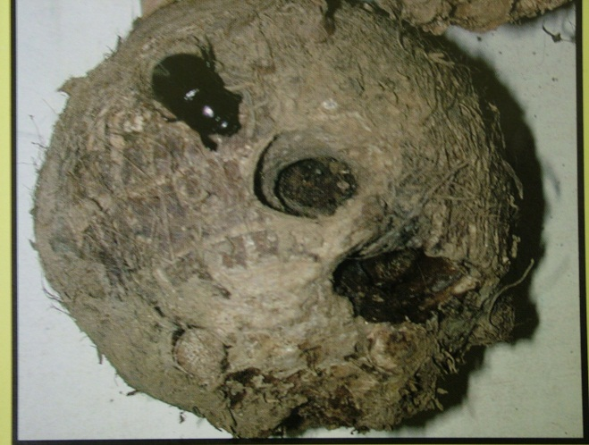
Bwabwai bitere (Taro beetle)
Teina: E roro ao n raneanea borana ao man matoatoa, 1.5-2.5cm abwakina
Ana urubwai: E amwarake n bukin te bwabwai, man te bwangabwanga aio ao ea kona n momoka te bwabwai, n onga ao n aki tau ibukin te kanaki
Aroka aika e maeu iai: Bwabwai , taororo ao tabioka
Taabo aika a rootaki n ana urubwai te biitere: Bon ti aon Tarawa (Teinainano & kaawan Teinaieta tabeua)
Anga aika e kona n roko iai: Uotakin aroka aikai mai Tarawa , uouotakin aroka ma tanoia, ao uouotakin te kamkamka ibukin kanan te aroka
Notes:
Natural enemies: tachinid fly, cane toad. None are considered effective in controlling populations
Biological control: fungus Metarhizium anisopliae. Works under experimental conditions but not yet recommended to farmers, difficult to maintain stocks of the fungus. E aki maiu i Kiribati.
The virus that infects coconut rhino beetle has been tried but to no success.
Cultural controls: clean planting materials (from soil & beetles), destruction of breeding sites near gardens.
Planting taro into a mulch formed by a legume cover crop keeps taros free of the beetle. Not known whether it is a physical barrier or other.
Legumes: Mucuna is most effective, Pueraria phasioloides and others.

Slide 10
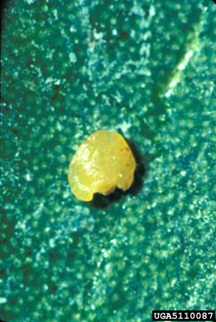
Ina iaon te uanikai (Scale insect)
Teina: Ti tebo tarakina ma inan te ika aika a uarereke, te man ae ti tebo ma iai rabunan ke katanan aona bwa kanga tein te ina. E kona n taraki bwa ti tebo e kirikiri iaon te uanikai ao maan aikai a bon aki naba kona n nakonako.
Ana urubwai: E temeka naba ranin te aroka ao ngkana ea rang n mwaiti ao e kona naba n roota uaan taian aroka
Aroka aika a maeu iaona: Bwabwaia ao uaan te Nii
Anga aika e kona n roko iai: Uotakin taian aroka ke uan te aroka ake a kaman tia n maeu iai man te tabo teuana nakon teuana

Slide 11
Bwata n Mai (Breadfruit rot)
Teina: E roro iaon kunin te mai ao ea rikirake naba buburana
E momoka te mai ao e aki tau ibukin te kanaki
Aroka aika e maeu iai: Ti te mai are akea korana
Anga aika e kona n roko iai: Man uotakin uaan te mai are a tia n ituaki n te aoraki
Aba aika a rotaki: E moan kaoti mai Butaritari ao ngkai e a rootii aba n te itera meang nakon te Itera nuuka.

Slide 12
Tabeua katoto iaon maan ao aoraki aika a tuai roko i Kiribati……..ti bon riai n taratara raoi !
Kinnongo uraura ae tenamwaaka
(Red imported fire ant)
Tineran te aba (Giant African snail)
Biiteren te Nii (Coconut rhinoceros beetle)

Slide 13
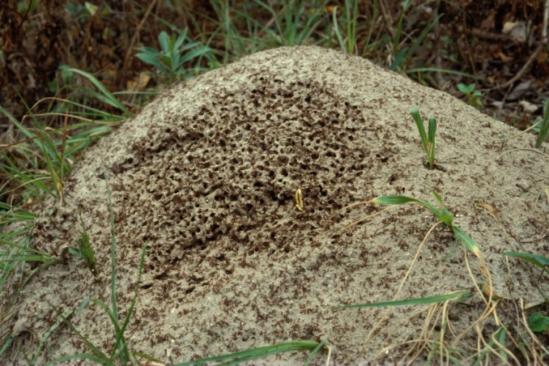
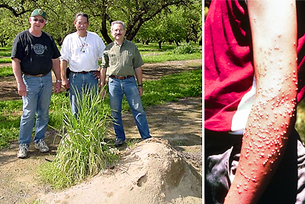
Kinnongo uraura ae tenamwaaka (Red imported fire ant)
Tarakina: Bon ti tebo raoi ma te kinnongo uraura, e kona n roko nte abwaki ae 5 mm
Ana urubwai: a kona n buraokina ke n urui bwaibu n ran ke n urua te iti, a kona n buakania bunin maan ke aika a tibwa bungiaki n aron te beeki ke tenan moa ke man ni kiba, e kona n tena te aomata ao man karika te kiritibutibu (ti tebo ma e miraki nte bingita)
Aaba ake ea tia n roko iai: Biiti, Kuam, Hawaii, Matiare, Nauru, Niukaretonia, Babua nukin, Samoa, Toromon, Tokelau, Tonga, Vanuatu & Wallis & Futuna
Aanga ake a kona n roko iai: Rabanako ribuakon kaako, taian kaa, ao bwain nanon te auti ke amwarake ao te tano

Slide 14
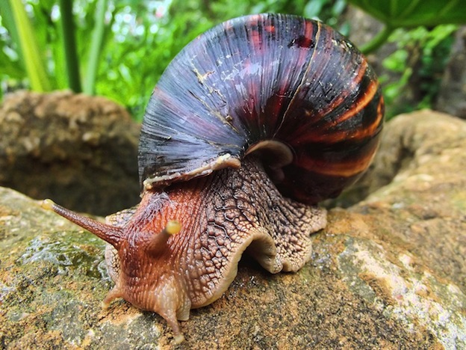
Tineeran te aba (Giant african snail)
Teina: Te tinera ma e kona n roko nte abwaki ae 15cm. Iai ana man ni kariki te aine ao te mwaane irouna ma ngkana e na kariki ao e na kainnanoi man ni kariki man 2 man aika kakaokoro. Temann te tineera e kona n karina 1000 te bunimoa ni katoa ririki.
Ana urubwai: E amwarake iaon kaai n aekaia nako ni ikotaki ma te mai, bwabwaia, tabioka.
Aaba aika ea tia n roko iai: Matiare, Tonga, Tamoa ao ai Federated States of Micronesia
Aanga aika e kona n roko iai: bunnimoana ribuakon te tano, nim ma tenan kaonteina ni kaako, nim ma tenan kaa

Slide 15
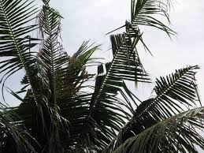
Biiteren te Nii (Coconut rhinoceros beetle)
Teina: E roro, iai korona ao e matoatoa borana, 4cm abwakina
Ana urubwai: Amarake n marewen te nii, ngkana a otinako baan te nii ao a makorokoro
E kauarerekea maitin baan te nii ao e kona naba n kakerikaka uaana ao maeuraoin te nii
Aba aika ea tia n roko iai: Biti, Toromon, Babua Nukin, Tamoa, Tokerau, Kuam, Aotiteria
Aanga aika e kona n roko iai: Rabanako ibuakon kaako, kanan te aroka aika a mka, bubu n tao ao aroka ake inanon nneia (pot plants)

Slide 16
Uouotakin aroka nako aonnaba ao totokoan uouotakin te man/aoraki
Tera te bwai ae ko riai ni karaoia ngkana iai arokam ae ko kan uotia nakon am abamwakoro?
Imwaain uotakin arokam nako aonnaba ao uoti arokam nakon te Botaki n ununiki tebongina imwain mwanangam
N rokon arokam ao e na karaoaki te tutuo nakon arokam. Iai aroka aika a na kona n kariaiakaki uotakiia ao iai aroka aika a na aki moa kariaiakaki iaan bukina are a kona n uouota te man.
A na tiku am aroka n te Ununiki ibukin te kaitiaki ao karaoakin bebwana ke te bebwa n kakoaua bwa a tia n tuoaki arokam ao akea te man ke te aoraki ae a uouotia.
Rooko anai arokam imwain mwanangam
Taben te tia ununiki iaon abamwakoro bwa e na tuoi arokam ao n tuoa naba bebwana
E na karaoa te kauoua n tutuo te tia ununiki, imwiin ana tutuo ao kona n anga ana babaire bwa e kariaia uotakin arokam ke aki.

Slide 17
Bwai ae kakawaki:
Tiaki ti taben te Botaki n Ununiki kamanoan abara man rokon maan ao aorakin aroka I abara bwa bon taben naba te botanaomata ao ngaira n tatabemanira nako
Ko kantaningaki bwa ngkana iai aekakin maan ke aorakin aroka aika ko kuba n boo ma ngaia ao n boou n am taratara ao te bwai ae ko riai n karaoia, ribooti nakon am Tia Ununiki are iaon am abamwakoro
Ribootini naba kanganga nakon arokam n mwengam are ko nori

Slide 18
Te uaia n ikarekebai ibukin kamanoan abara aika a kakateke aikai bon te tibwanga ae moan te kakawaki.

Slide 22
Te kinnongo ae babobo man biriaitua
Teina: E babobo n buraun ao a rang n ananau waena
Ana urubwai: Urubwai nakon kain amwarake ao man kona naba n urubwai nakoia maan n aron bunin tenan moa ke man ni kiba (a rotaki aia taratara) ngkana e katinakoa ana ran ae boitin, ai aron naba ma te mwanai ae a kona n rotaki aia taratara ao tokin te tai a mate, ao man karika te kanganga naba nakon te mwenga n tain te matu riki nakoia ataei aika a uarereke ao nte tabo n amwarake ngkana ea rang n rawata
Aba aika a rotaki: Amerikan Tamoa, Aotiteria, Te aono n Kuuka, Niukaretonia, Niutiran, Babua Nukin, Tamoa, Toromon, Toonga, Tuvalu, Wanuatu, Wallis & Futuna

Slide 23
Tineikin te kai ae Buraun
Teina: Kanga tein raoi te tineiki ma e babobo n buraun
Ana urubwai: e amwarake n uanikai ao kaai riki ake a bon kona n riki nte aba
Aaba aika ea roko iai: Aotiteria, Kuam, Matiare, Palau, Toromon, Wallis & Futuna
Anga aika e kona n roko iai: Rabanako nte wanikiba, kaako ake a uouotaki nte kaibuke, bao n mamananga I taari ao ai taian kai aika a beibeti

